Slide 1
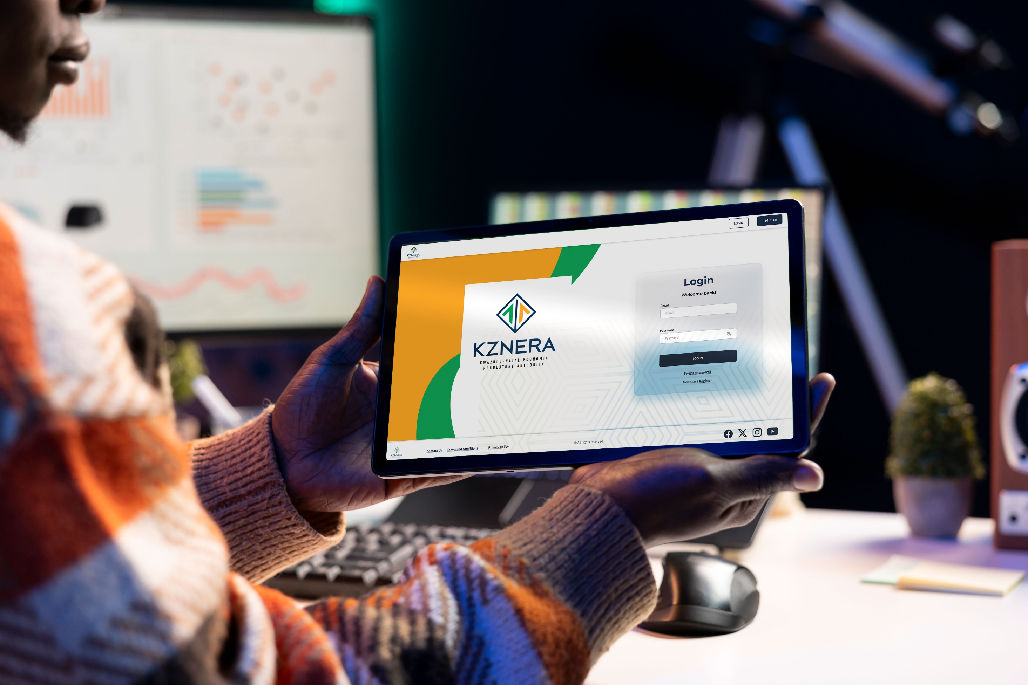


Presentation for KZNERA
Application update changes - 08 September 2025
Presented by

Slide 2
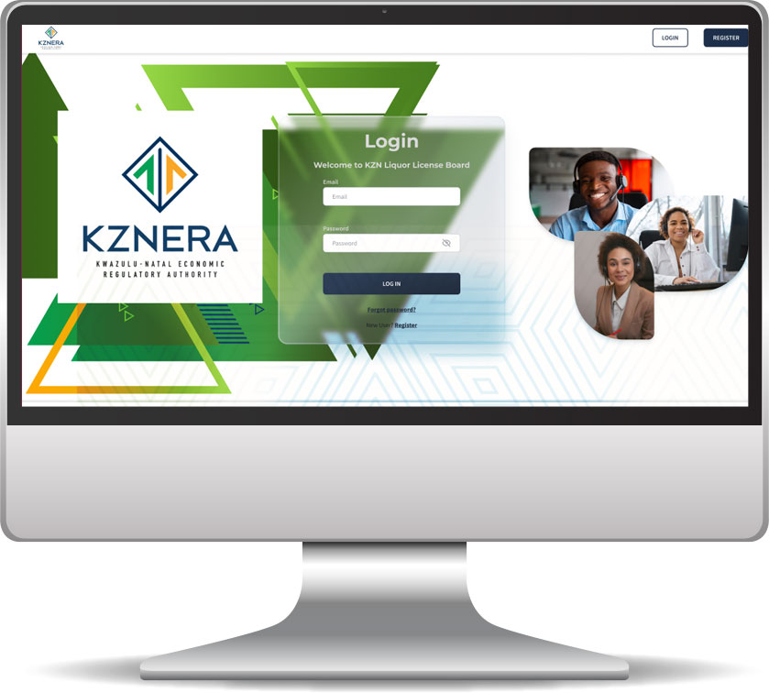
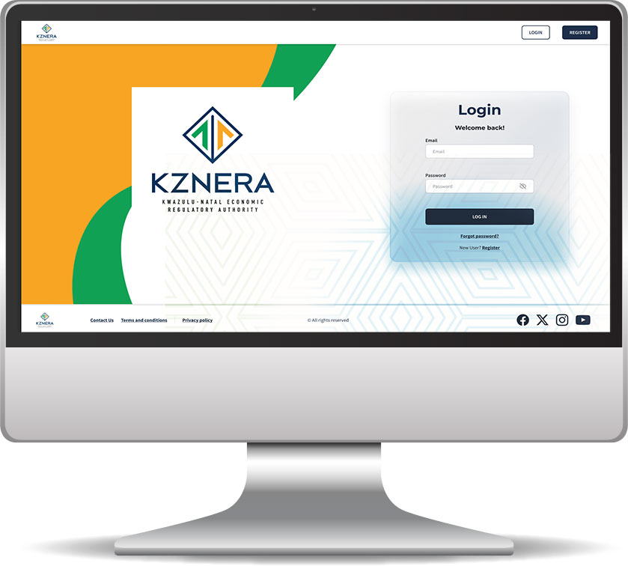
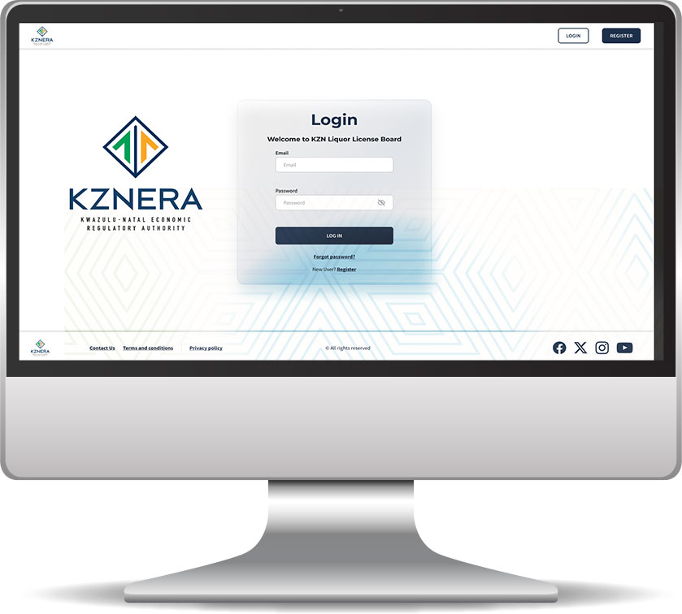
Proposed Landing page layouts
Three layouts to consider
j
k
l
Presented by

Slide 3
Proposed Landing page layouts
Three layouts to consider
j
k
Presented by

Slide 4
Proposed Landing page layouts
Three layouts to consider
k
k
Presented by

Slide 5
Proposed Landing page layouts
Three layouts to consider
l
Presented by

Slide 6
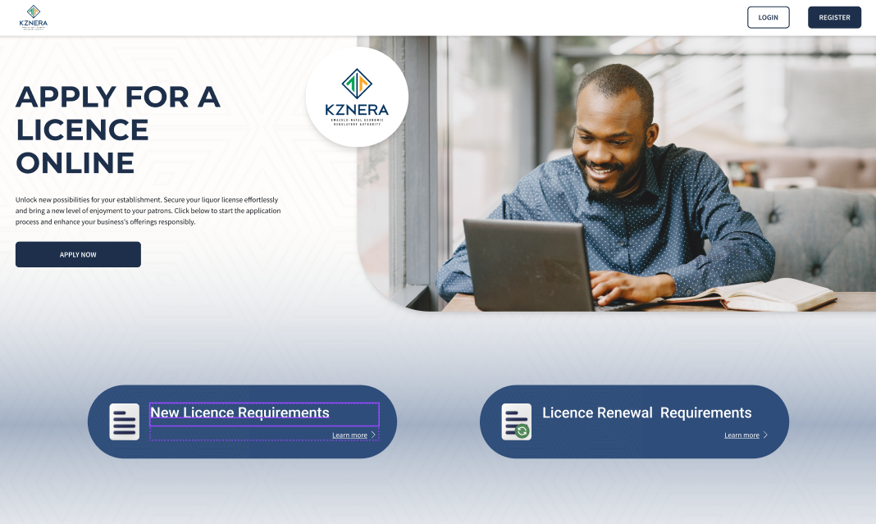
Logo updated
Request for Logo must be changed to the one supplied. Done
Presented by

Slide 7
Currently 4 Blocks - Must be 2 Blocks
Request to remove the other blocks: Done
Presented by

Slide 8
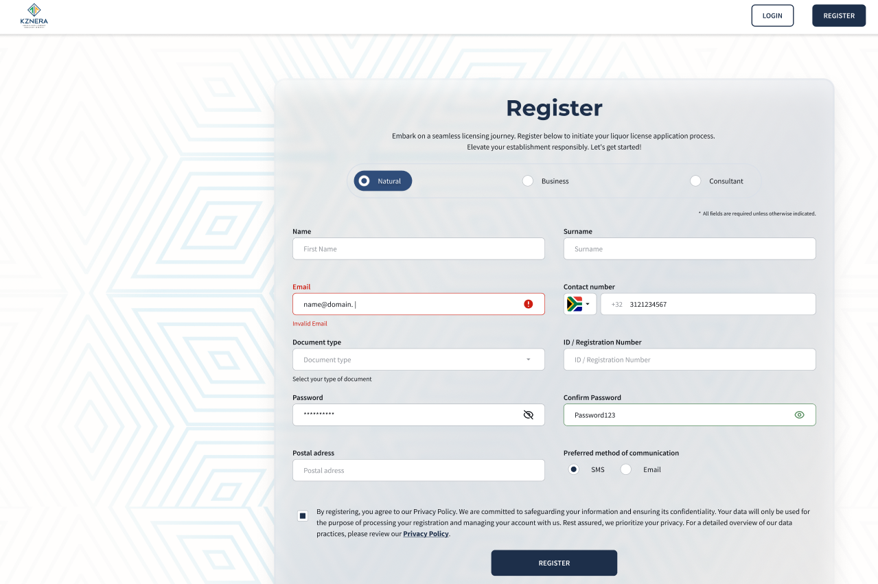
Changes on Registration application form
Request to change the labels i.e. 1. Natural, 2. Business, 3. Consultant. Removal of Municipality dropdown
Presented by

Slide 9
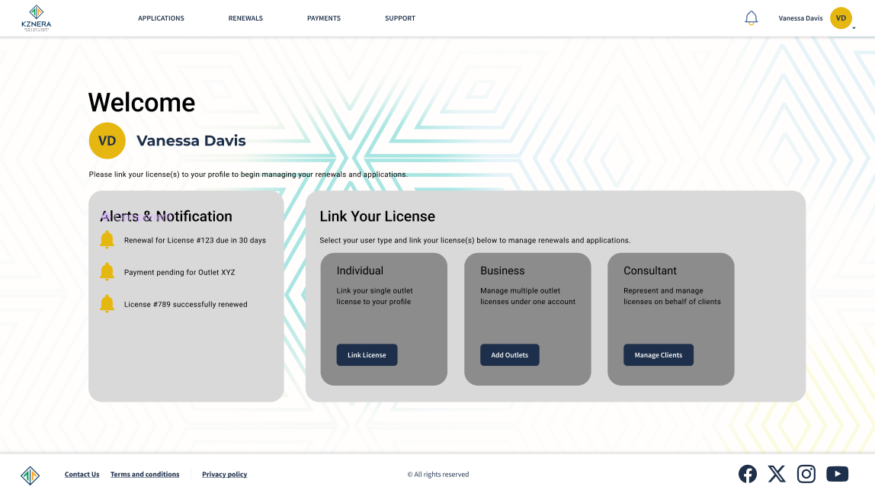
Landing Page (Post-Login) Design Suggestion
User linking their license(s) to their online profile
Presented by

